Slide 1
Multicast routing

Slide 2
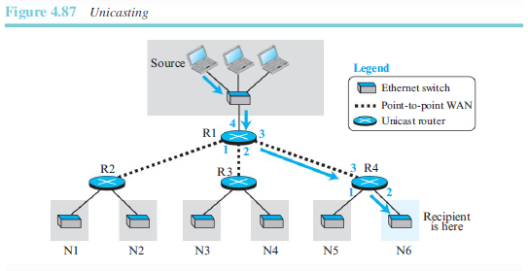
Unicasting
In unicasting, there is one source and one destination network.
The relationship between the source and the destination network is one to one.
Each router in the path of the datagram tries to forward the packet to one and only one of its interfaces

Slide 3
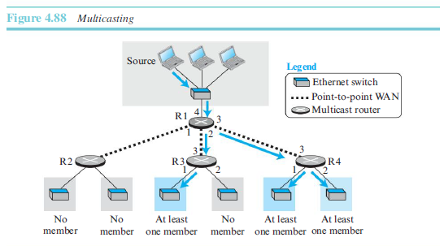
Multicasting
In multicasting, a multicast router may have to send out copies of the same datagram through more than one interface.
In Figure, router R1 needs to send out the datagram through interfaces 2 and 3. Similarly, router R4 needs to send out the datagram through both its interfaces.

Slide 4
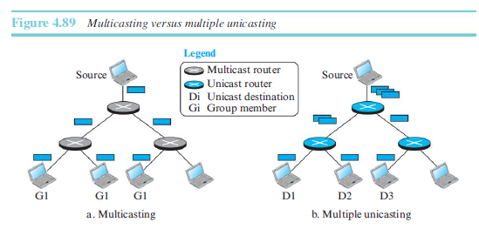
Multicasting versus multiple unicasting
Multicasting starts with a single packet from the source that is duplicated by the routers.
Only a single copy of the packet travels between any two router
In multiple unicasting, several packets start from the source. If there are three destinations,
for example, the source sends three packets, each with a different unicast destination address

Slide 5
Multicast Applications
Access to Distributed Databases
Information Dissemination
Teleconferencing
Distance Learning

Slide 6
Broadcasting
Broadcasting means one-to-all communication: a host sends a packet to all hosts in an internet.
it may create a huge volume of traffic and use a huge amount of bandwidth.

